Slide 1
Loan Payments Data
Summary of Machine Learning Models and EDA
to understand
customer characteristics based on loan repayment.
Author : Priyanka Sharma Date: April 2020

Slide 2
Loan Payment data Set
Attributes
Loan_id : A unique loan number assigned to each loan customers
Loan_status: Whether a loan is paid off, in collection, new customer yet to payoff, or paid off after the collection efforts
Principal: Basic principal loan amount at the origination terms, could be weekly (7 days), biweekly, and monthly payoff schedule
effective_date: When the loan got originated and took effects
due_date: Since it’s one-time payoff schedule, each loan has one single due date
paidoff_time: The actual time a customer pays off the loan
pastdue_days: How many days a loan has been past due
age, education, Gender: A customer’s basic demographic information
Loan_status variable (3 categories)
PAIDOFF : loan paid off by the customers
COLLETION : loan is yet to be paid off so bank is collecting money from those customers who seem to be unwilling to repay the loan amount
COLLECTION_PAIDOFF : the loan amount was repaid by the customers after conducting Collection drive.
Note : The presentation focuses on Summary and EDA visualizations are self explanatory. Overall observations are given as conclusions.

Slide 3
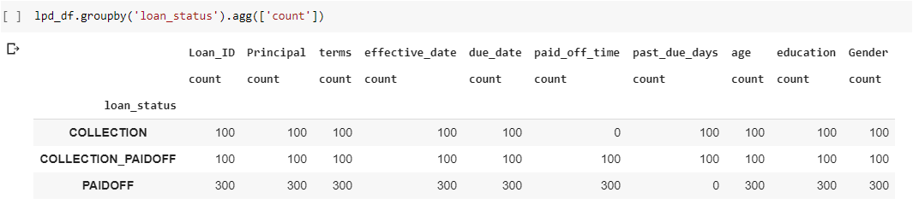
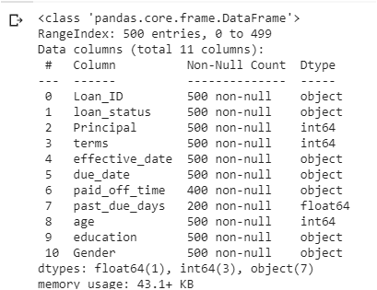
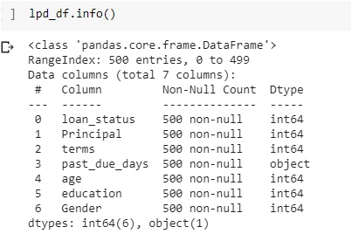
Loan Payment data
10 column and 500 rows data set classified basis Loan _ Status
Data set cleaned, non essential variables deleted to construct sanitised dataset with following variables.

Slide 4
Key Variable: Loan Status
Loan_ Status is identified as key variable (label).
Data gets split row wise and adds a new characteristics of customer basis who paid and did not pay onetime.
Loan Payment data for exploratory data analysis ( EDA) named as follows :
cred_df : the entire data set.
cred_df2: subset if cred_df for customers who PAIDOFF on time.
cred_df1 :subset of cred_df ; for customers who paid after due date; where 0= collection & 1= collection paid off.
Logistic regression : key variable ( Loan Status ) has been converted to numeric form and classified basis when customers who paid back. Consequent sub classification of dataset (row wise);
lpd_df :the entire data set.
lpd_df2: customers who pad by due date.
lpd_df1 : paid after due date collection calls where 0= collection & 1= collection paid off.
Decision Tree and Radom Forest : Data set named as train_df, covers all classes of loan status.
Data set is not split for Decision Tree and Random-forest as the author intends to use these models for identifying interrelationship between variables.
Logistic regression , Decision Tree and Random Forest using Loan Status as key variable have 3 classifications and thus gives 3 variable confusion matrix.
Logistic Regression, train: test split :: 70:30, is based on a row wise classification of customer who paid after due date ( lpd_df1).
The presentation focuses on summary and EDA visualizations are self explanatory. Over all observations are given as conclusions.

Slide 5
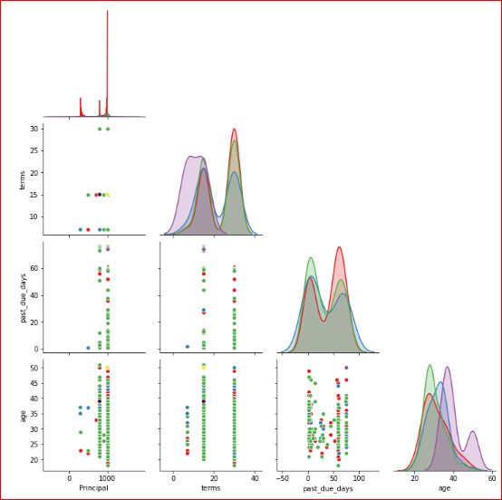
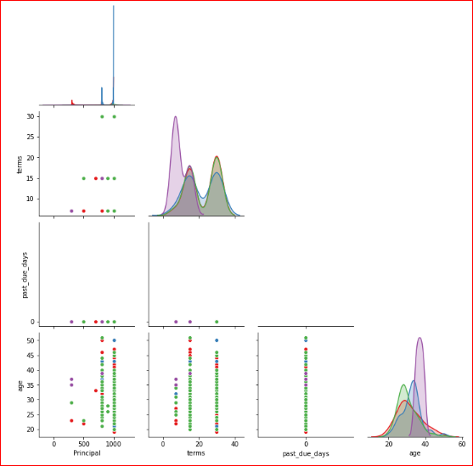
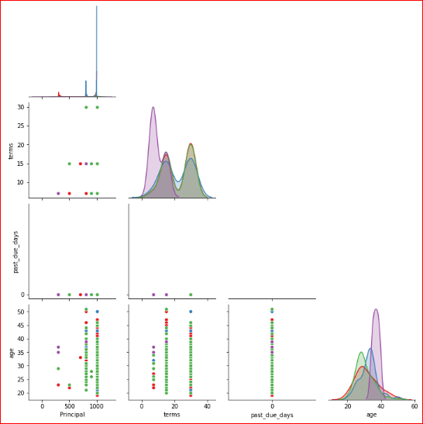



Pairs Plot discussing education
Loan Status – All Classes
Loan Paid on time ( cred_df2)
Loan Paid : All classes ( cred_df)
Loan Paid before due date( cred_df2)
Loan Paid after due date( cred_df1)

Slide 6
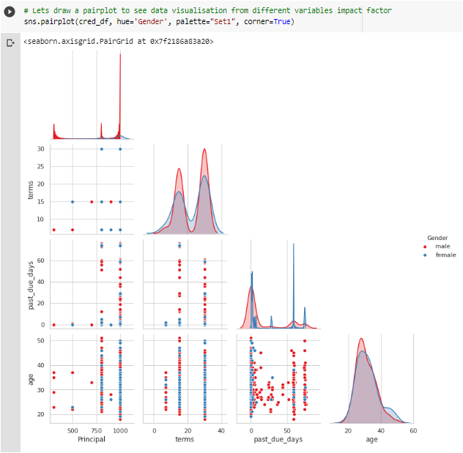
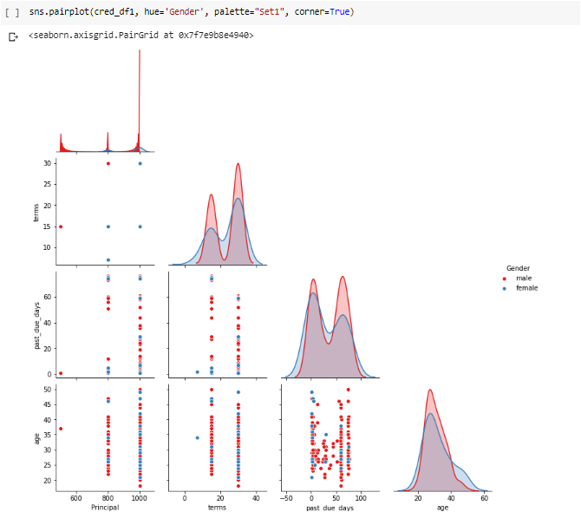
Pairs Plot Discussing education
Loan Paid : All classes ( cred_df)
Loan Paid after due date( cred_df1)

Slide 7
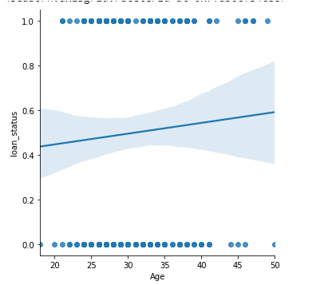
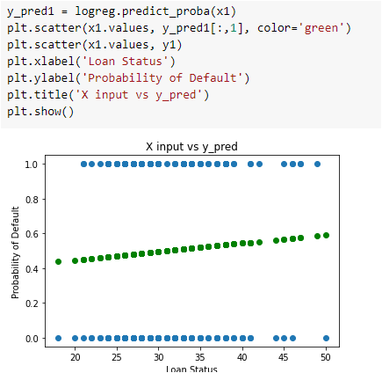
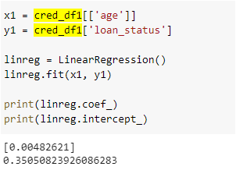
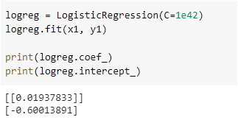
Regression Plot: Visualisation
Linear
Logistic

Slide 8
Summary of models
Model | Sub classification | Name of dataset | Accuracy Score | Remarks
Logistic Regression | Loan Status: All Classes- ( Train ) | lpd_df | 0.968571 | Train test split : 70 % train data
Logistic Regression | Loan Status: All Classes- ( Test ) | lpd_df | 0.98667 | Train test split : 30 % test data
Logistic Regression | Loan Status: Paid Post Due Dt Classes- ( Train ) | lpd_df1 | 0.9642 | lpd_df1: all customers who paid after due date.
Logistic Regression | Loan Status: Paid Post Due Dt Classes- ( Test) | lpd_df1 | 0.9333 | Lower score could be because of smaller size of dataset.
Decision Tree | Loan Status : All classes | my_tree_2 | 0.986 | Random parameters, dataset not split.
Decision Tree | Loan Status : All classes | my_tree_three | 0.998 | Using parameters from Grid search Max depth=10, criterion = gini
Random Forest | Loan Status : All classes | my_forest | 0.998 | Random parameters, dataset not split.
Random Forest | Loan Status : All classes | rf_random | 0.9819 | Using parameters from Randomised search.

Slide 9
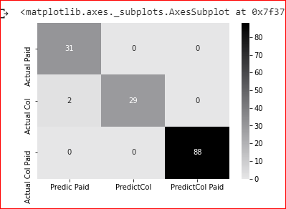
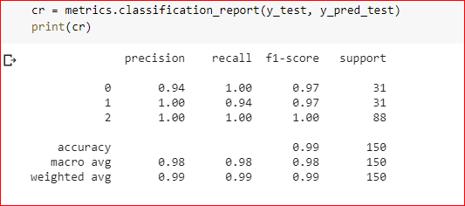
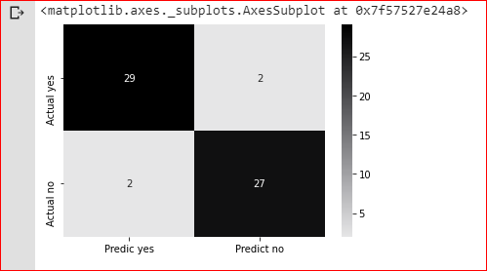
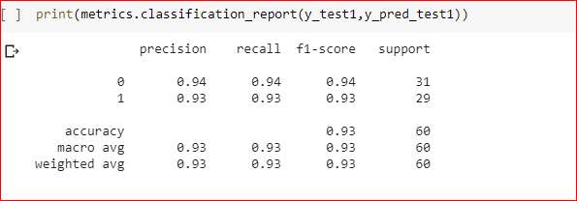
Post after Due date (lpd_df1)
Logistic Regression: Model Comparison
Logistic Regression
Loan Status: All (lpd_df)

Slide 10
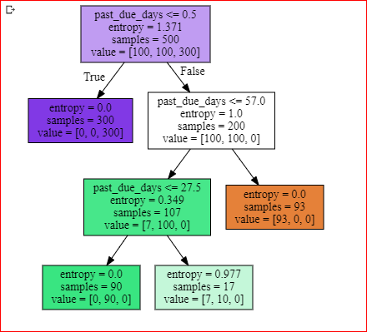
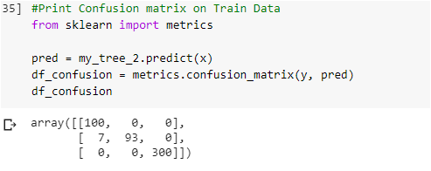
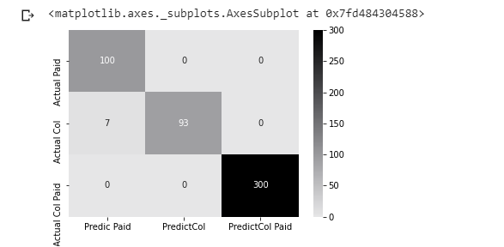
Decision Tree
Conf. matrix: my_tree_2 ( max depth 4, criterion= ‘entropy’)
my_tree_2

Slide 11
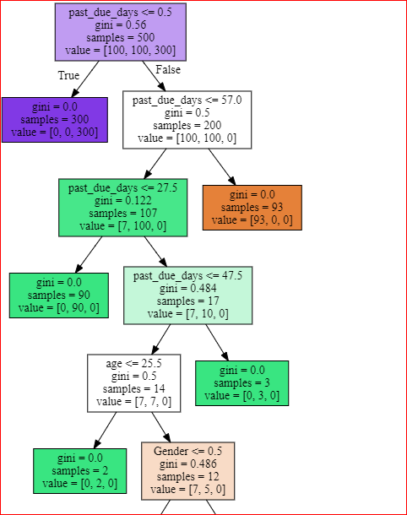
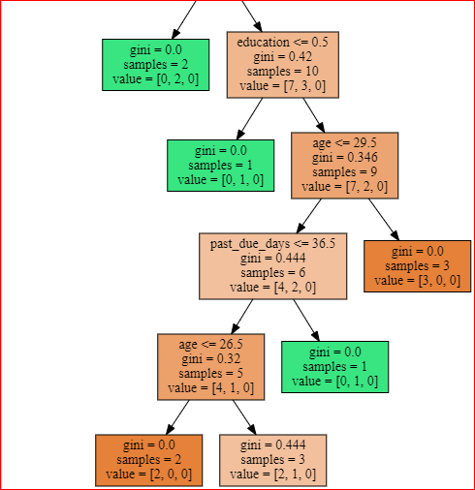
Decision Tree
my_tree_2
my_tree_2
my_tree_tree ( based on Grid Search) Parameters ; max depth =10 , criterion =gini

Slide 12
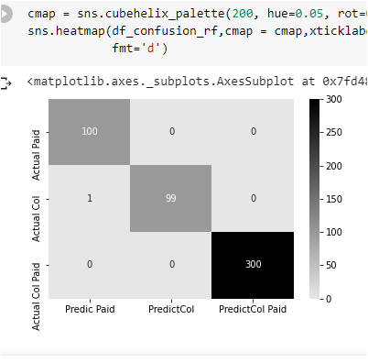
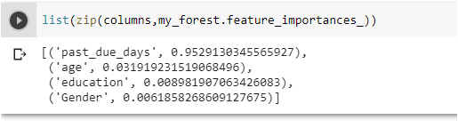
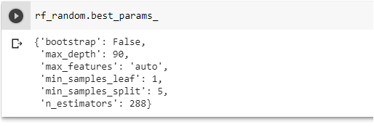
Random Forest
Best Parameter : (my_forest)
Best Parameter basis function “Randomised search” (rf_random)

Slide 13
Conclusions
Observations for variables ‘Principal’ and ‘term’ do not have large variations. This reduces complexity of the data set.
Increase in age females take higher loan amounts and are more likely to delay compared to men. The pattern remains the same when we compare the entire data set with its subset of who paid on time.
In general the subsets based on when the loan was paid mirror the population.
Age variable used to visualize regression plots since they have a fair spread of values. Incidentally for this data set are normally distributed and corroborate statement made in point 3( above).
All accuracy scores are derived from ML models are pretty close to 100% indicating all models are effective. It a competition of effective and more effective!
Three Variable confusion matrix: main diagonal values are “True Positive”.
Python code file submitted.

Slide 14
You are welcome to write to the author at
priyanka.krishna.sharma@gmail.com

